Slide 1
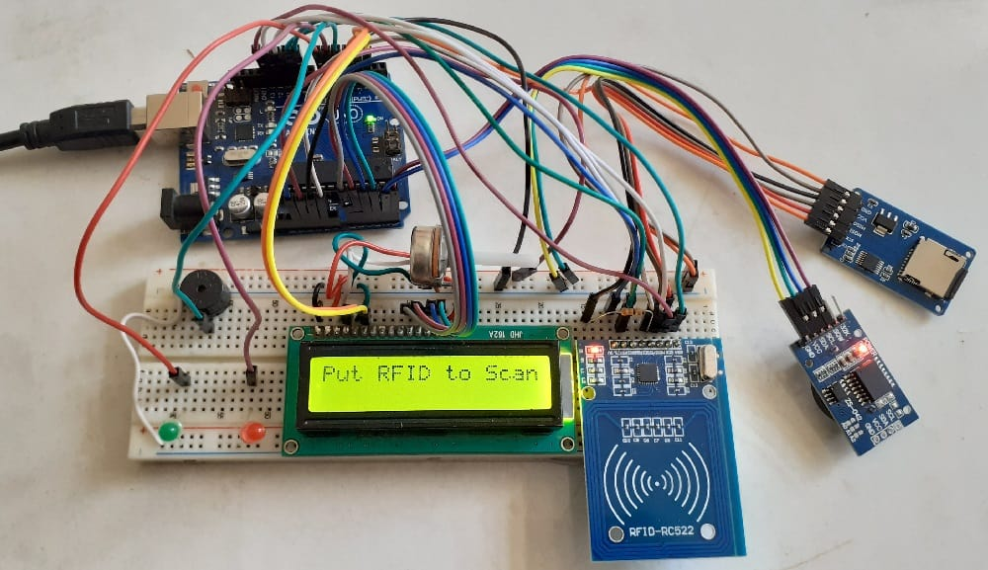
RFID based Attendance System
Design lab project
Professor: Dr. Saurabh kumar pandey
Semiconductor devices panel
Date: 5th may, 2023.
Prepared by:
Aman Jha
2001Ee22
Subtitle

Slide 2
Purpose of the project
The conventional method of taking attendance by calling names or signing on paper is very time consuming and insecure, hence inefficient.
Radio Frequency Identification (RFID) based attendance system is one of the solutions to address this problem.
This system can be used to take attendance for student in school, college, and university. It also can be used to take attendance for workers in working places.
Its ability to uniquely identify each person based on their RFID tag type of ID card make the process of taking the attendance easier, faster and secure as compared to conventional method.
Students or workers only need to place their ID card on the reader and their attendance will be taken immediately.

Slide 3
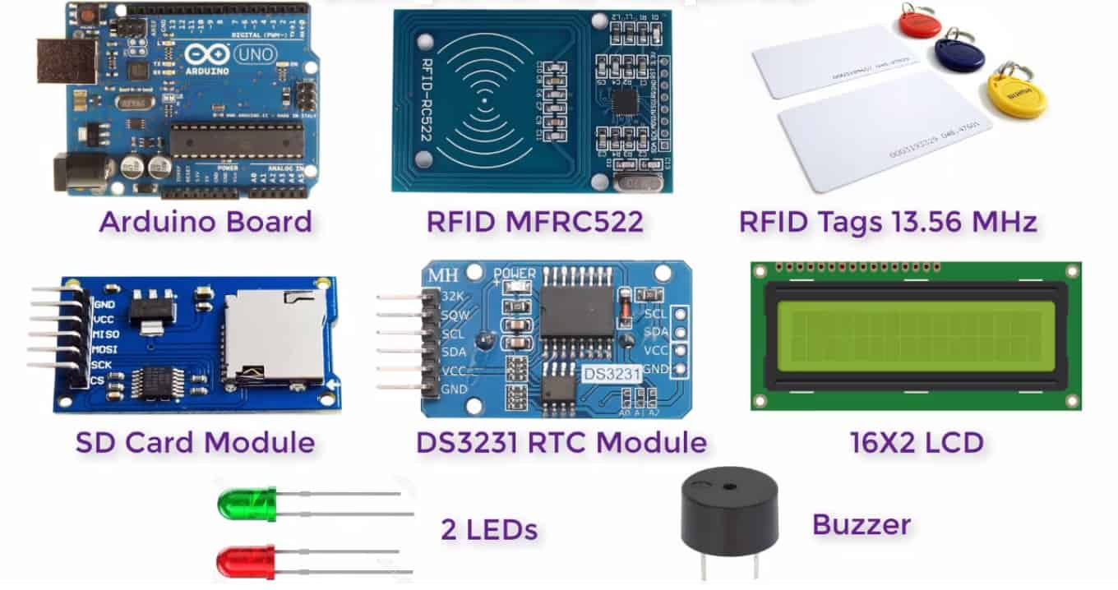
Components Used

Slide 4
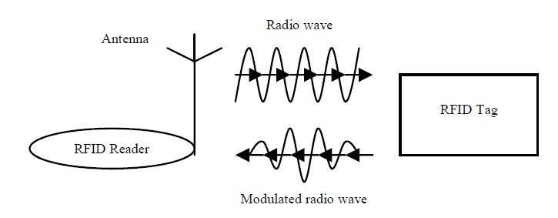
Basic operation of RFID
A basic RFID system usually consists of a RFID reader and RFID tag which contain a coil that serves as antenna for transmitting and receiving signals as shown below.
All kinds of RFID system operate using similar concept.
RFID readers generate radio wave that reaches the RFID tags. Then, RFID tags use backscatter technology to reflect back the radio wave which has been combined with the data through modulation to the reader.

Slide 5
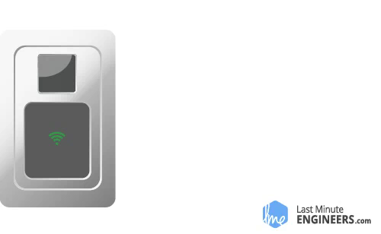
Working of RFID

Slide 6
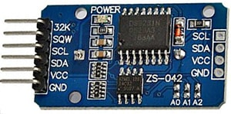
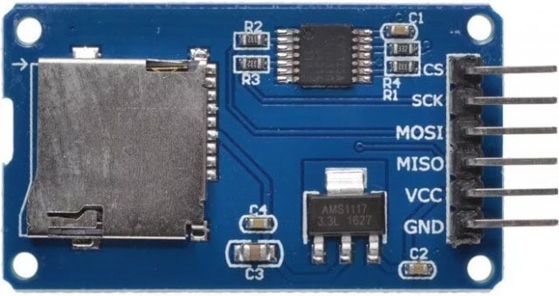
SD Card Module
DS3231 RTC Module
RTC means Real-Time Clock. RTC modules are simply TIME and DATE remembering systems that have battery setup which in the absence of external power keeps the module running.
This keeps the TIME and DATE up to date. So we can have accurate TIME and DATE from the RTC module whenever we want.
SD Card Module is used for transferring data to and from a standard SD card. The pin out is directly compatible with Arduino.
It allows to add mass storage and data logging and greatly expand the capability an Arduino can do with their poor limited memory.

Slide 7
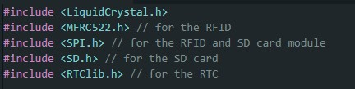
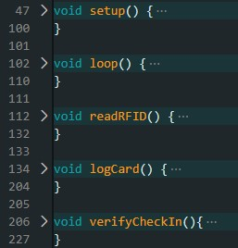
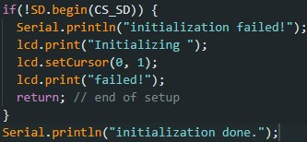
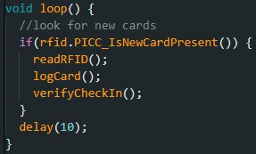
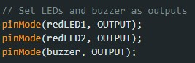
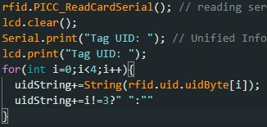
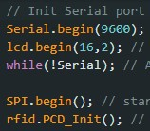
Here we have included all the needed libraries and mentioned for which hardware they are included, and after this we instantiated objects and declared variables which will be used as our pins or for storing values.
Then, we have divided our code into five functions. Setup functions integrates the hardware and software and gets it ready for use, loop function is our main function which runs until we remove our hardware from the computer Remaining 3 functions are a part of loop function.
SD.begin(ss_pin) initializes the SD library and card. It initializes the SPI bus, which is used for communication between Arduino and SD card.
This is our loop function, in this function we check if any rfid card is present, if yes we go inside the function and run 3 mentioned functions, otherwise wait for 10 ms and run again.
We are setting output pins with the help of pinMode(pin,output/ input) function. We have 2 LEDs and 1 buzzer as output.
This is readRFID function where we read the card serial number. We clear the lcd and print on lcd and our monitor and then store the UID in our string
We are connecting to serial port at 9600 bps and starting the lcd with 16 columns and 2 rows. While(!serial); line makes the board pause until you open the serial port. We also create a rfid object here.

Slide 8
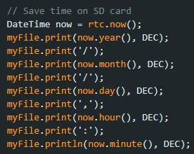
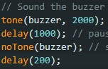
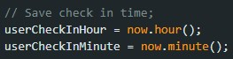
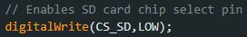
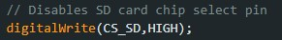
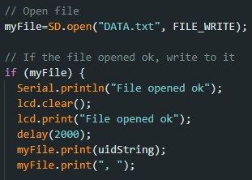
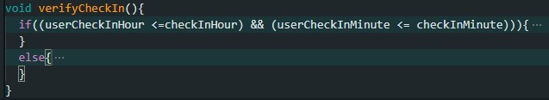
This is readRFID function where we read the card serial number. We clear the lcd and print on lcd, monitor and then store in UIDstring.
It is reading time through rtc.now() function from DateTime module, and then writing in year/month/date, hour:minute format in myFile, LCD and our serial monitor.
Here we start the buzzer by tone function and send a 2000 Hz sound signal for the buzzer, wait for 1 s and then turn off the buzzer by notone( function and then again wait for 0.2s.
Here we are saving login time for user in our variables by now.hour() and now.minute() function.
We are enabling our SD card by digitalWrite function.
We are enabling our SD card by digitalWrite function.
We open our file in which we are writing our data, if we successfully open pour file then we display the message for the same on lcd and monitor. We also store our UID number in our file.
This is our last function from loop function which is our verifyCheckIn, in this we check our login time, then 1st Red LED glows and a welcome message is shown on the screen, otherwise it shows the message that we are late.

Slide 9
Flowchart
Login time from RTC module is sent to SD Card
RFID tag sends data to RFID reader
Reader decrypts message and sends it to SD card
Person information with login time, together are stored in SD Card and displayed on LCD
Start
LCD prints “You are late”
NO
Is the person on time
Attendance system checks login time& compares with its database
LCD prints “You are on time”
YES

Slide 10
Scope of improvement
Future directions, the first goal is to extend the proposed system to include staff information as well.
To extend the system to encompass more than one faculty with the insertion of a face detection mechanism in the attendance monitoring system to control card replacements among different students.
Providing a user interface of Android focused on providing data about the person's attendance and statics about class missed, attendance percentage etc.
Implementing Multimedia Card (MMC) will help attendance be retrieved directly from files stored inside the MMC card.
By detecting the time of exit of a person for which he/she may or may not need to touch their card again by having a sufficiently long-range RFID tag, this can help to determine hours spent in the school, college, office etc

Slide 11

THANK YOU

